Slide 1
Virtual network in azure

Slide 2
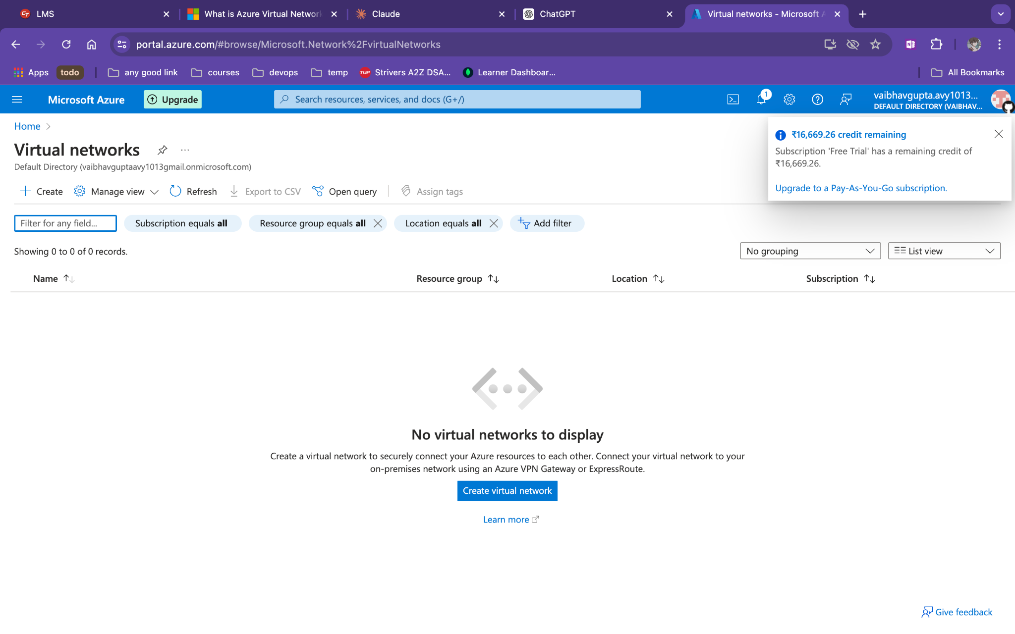
Create a virtual machine

Slide 3
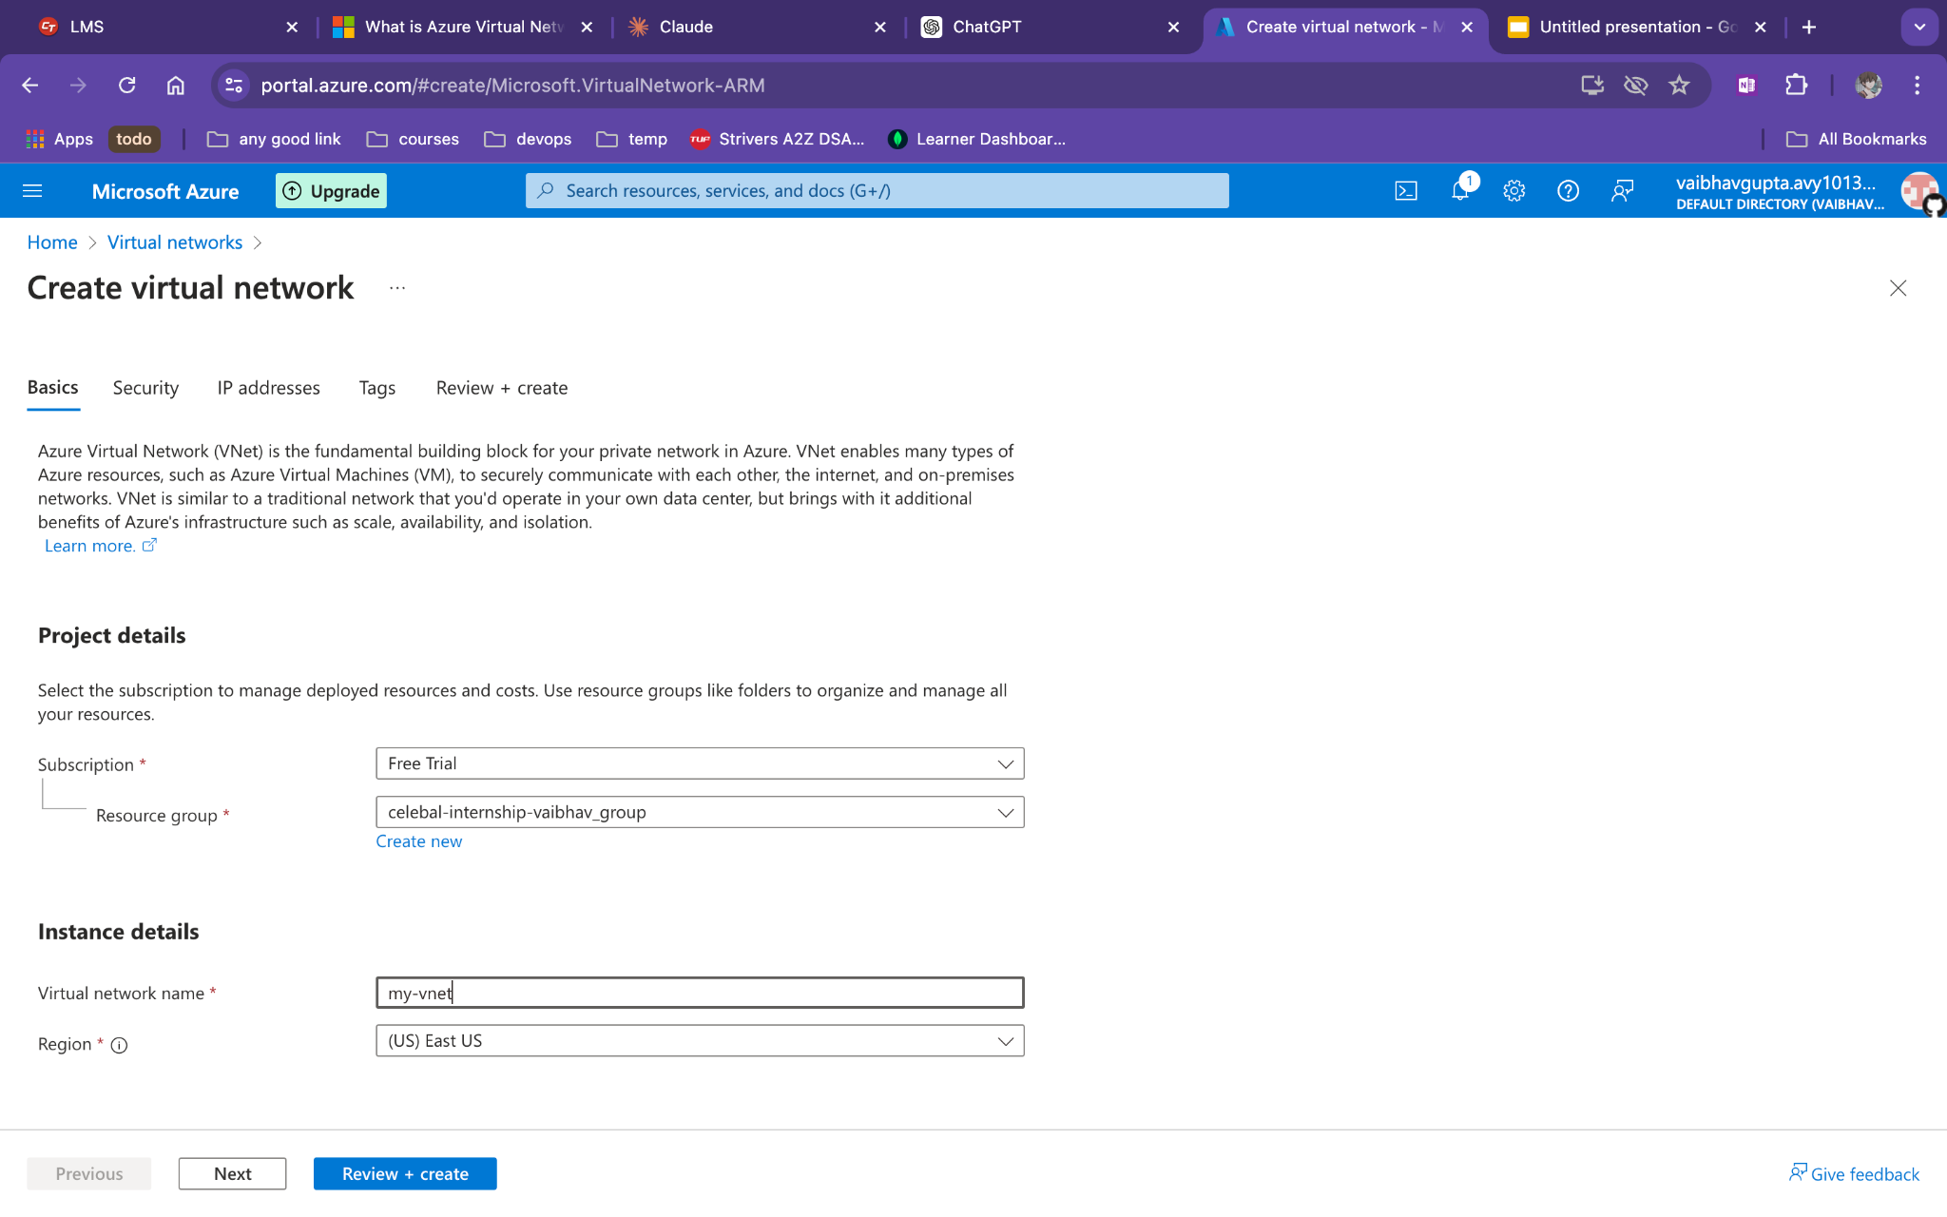
Add name of vnet

Slide 4
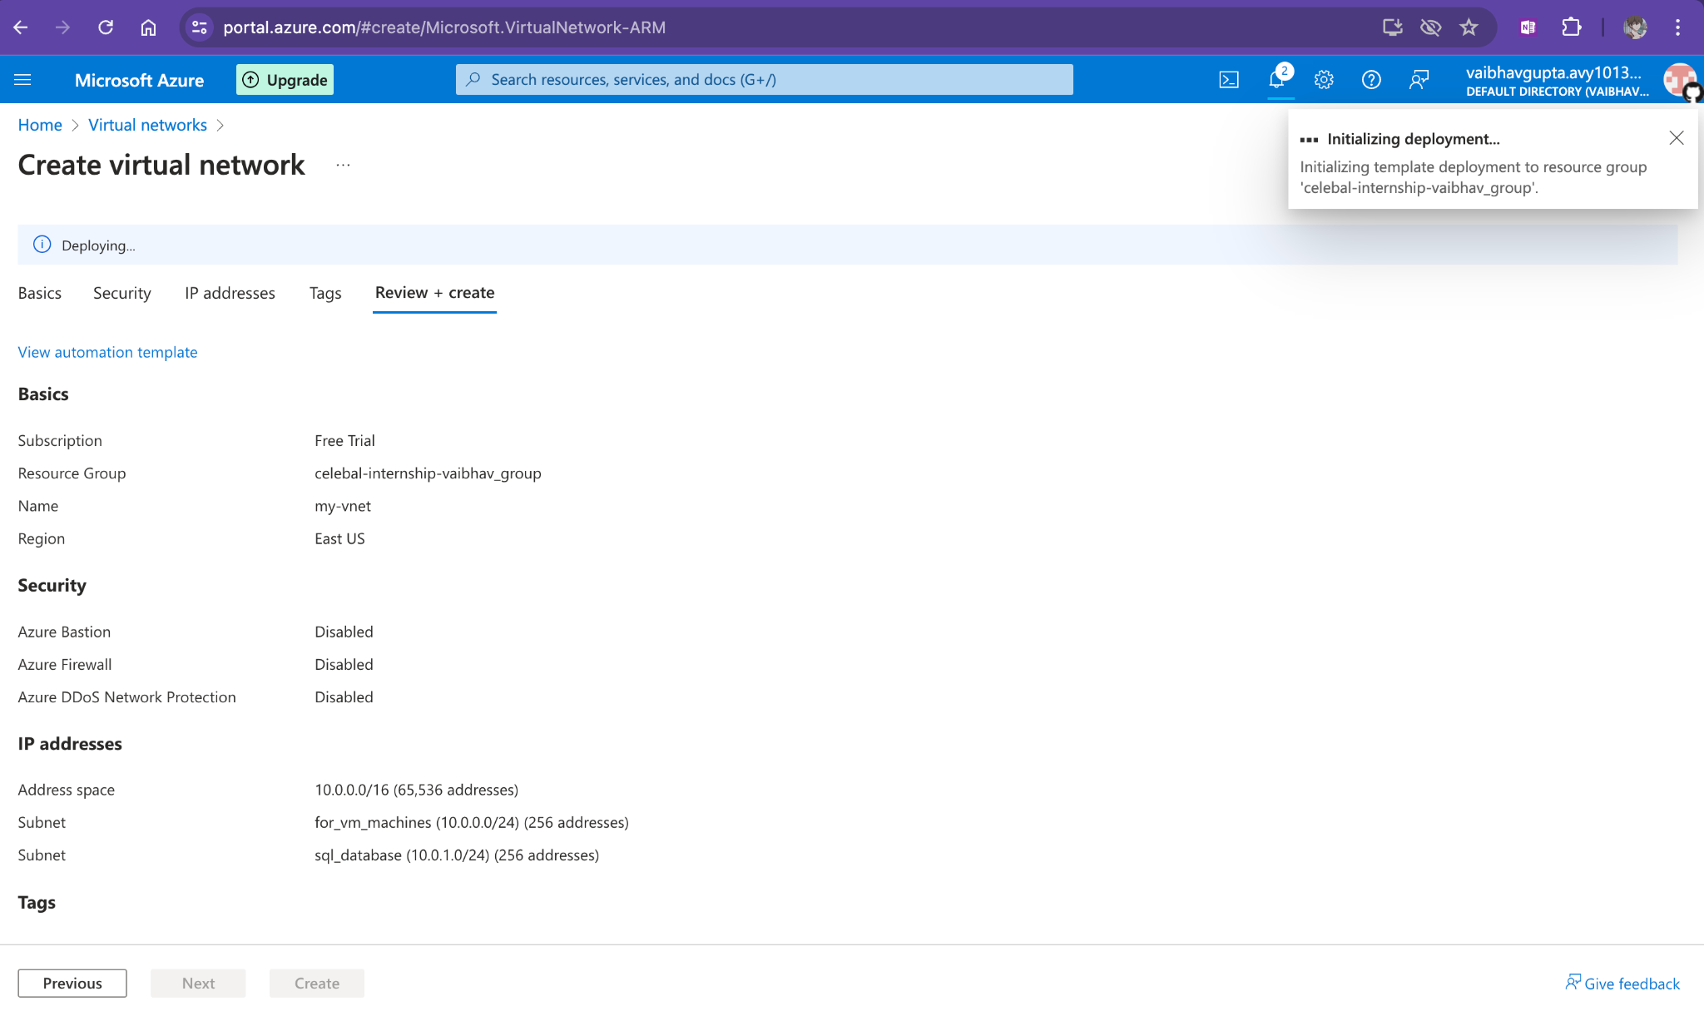
After adding a subnet
Create it

Slide 5
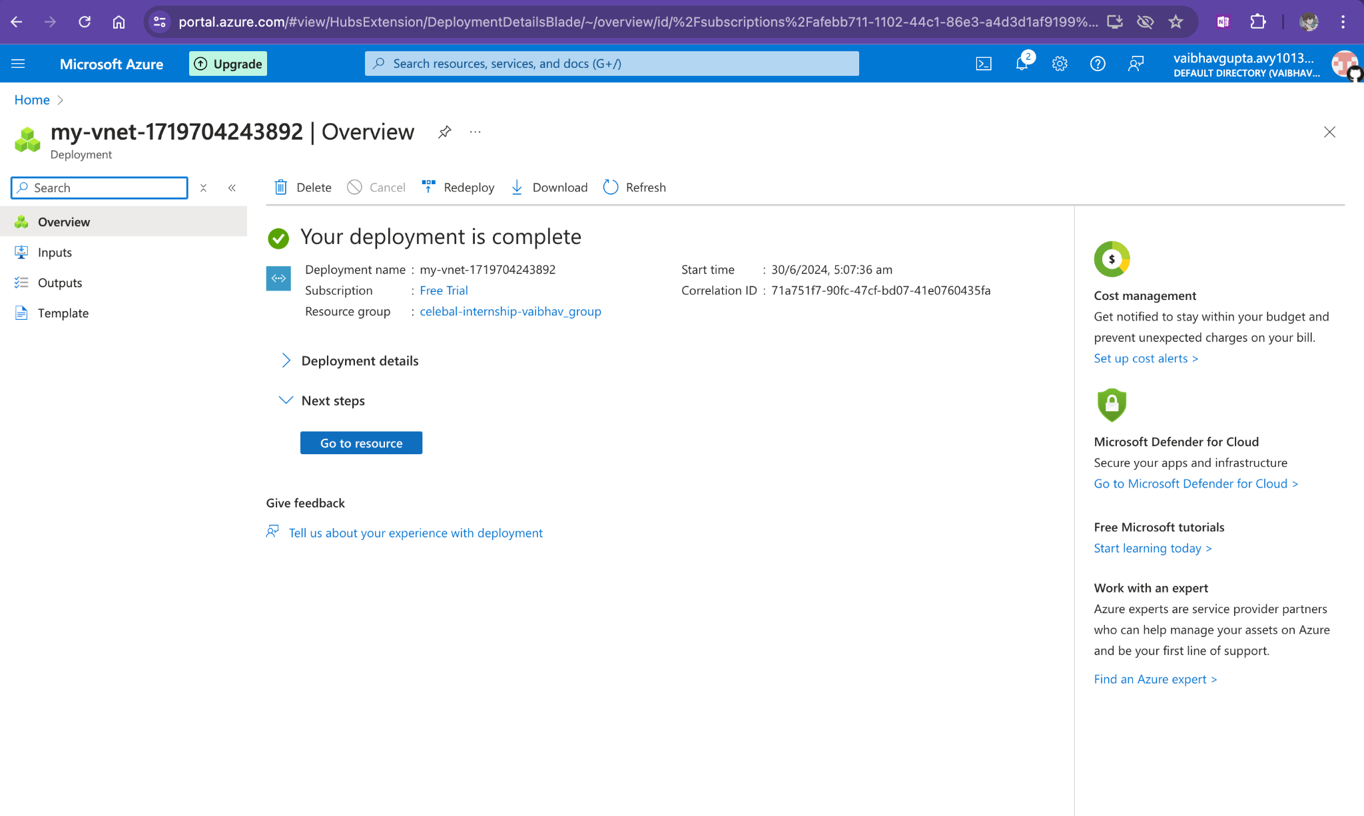

Slide 6
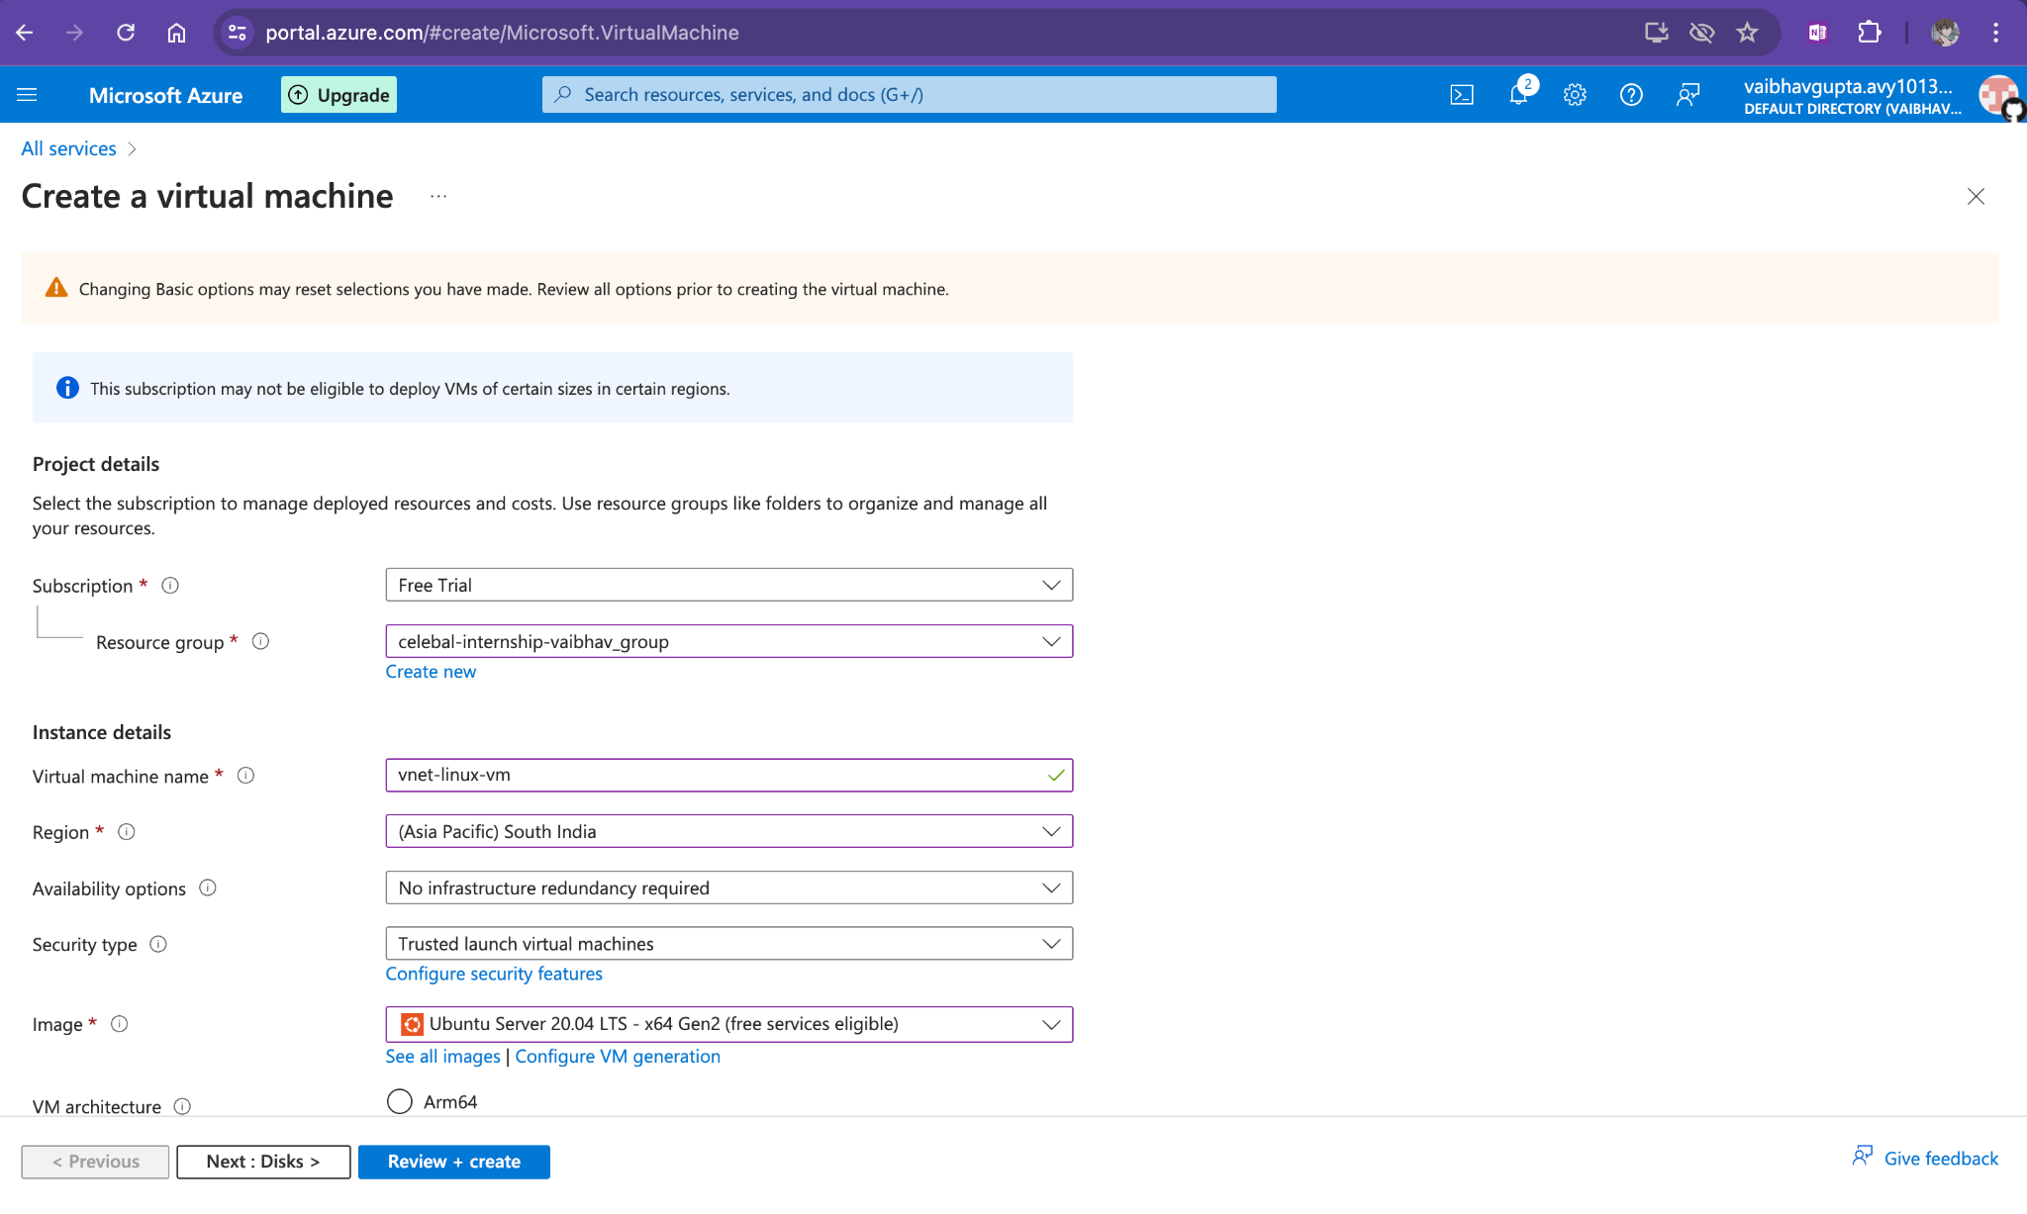
Create it in the same region

Slide 7
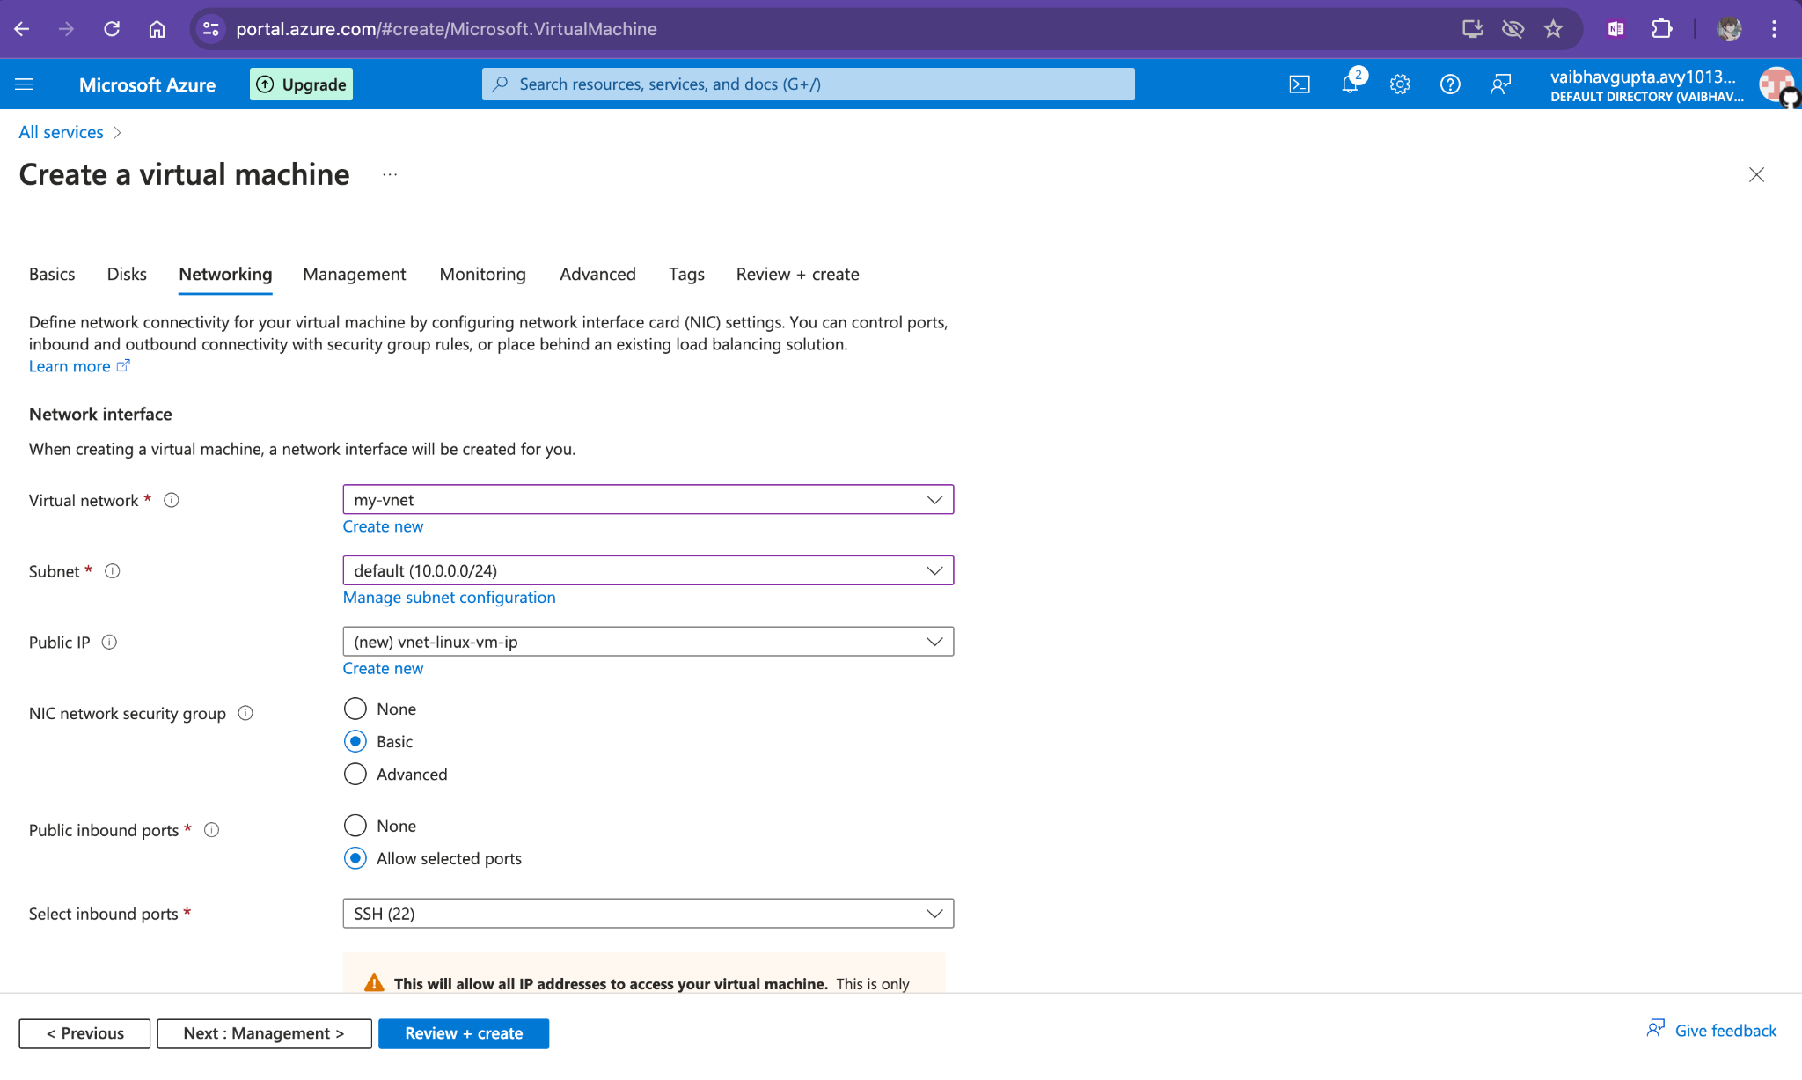
Add custom vnet in networking

Slide 8

Do same for windows...

Slide 9
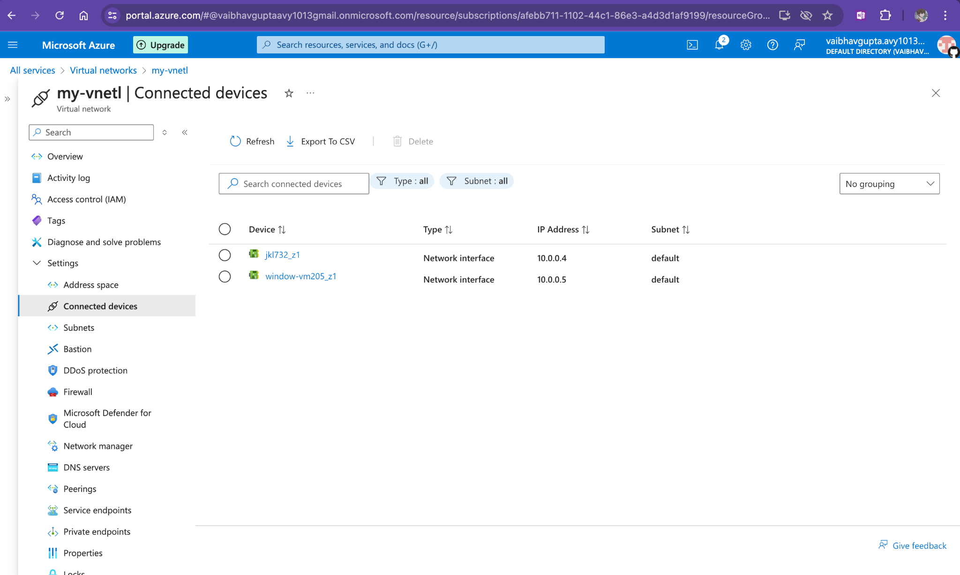
Two vm in one subnet

